Slide 1

Encryption/Decryption Tool.
Prepared by: Salome Dolbadze

Slide 2

Project Overview
Topic: Encryption/Decryption ToolPurpose: Explore simple encryption techniquesImplemented Algorithms: Caesar Cipher, XOR Cipher, AES WrapperGoal: Understand how data can be encrypted and decrypted securely

Slide 3

What is Encryption?
Encryption converts plaintext into unreadable ciphertextProtects information from unauthorized usersExample: HELLO → KHOOR (Caesar Cipher)

Slide 4

Why Encryption is Important
Ensures confidentiality, integrity, authenticationProtects passwords, communications, sensitive dataPrevents data theft and unauthorized access

Slide 5
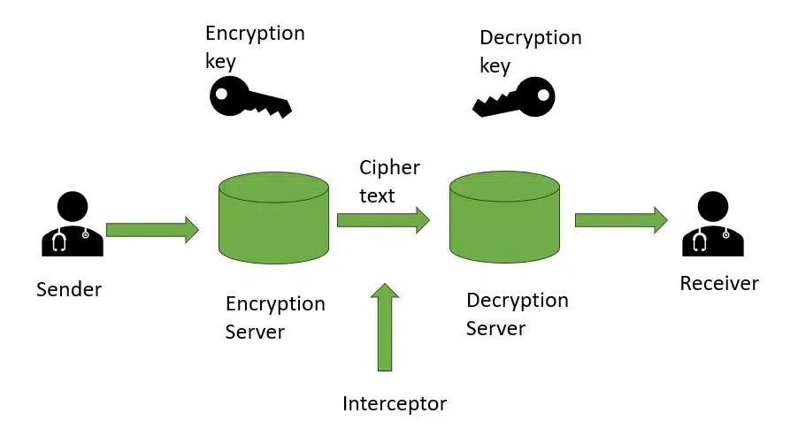
Types of Encryption
1. Caesar Cipher – simple letter shifting.2. XOR Cipher – logical XOR operation.3. AES – modern and secure encryption standard.

Slide 6
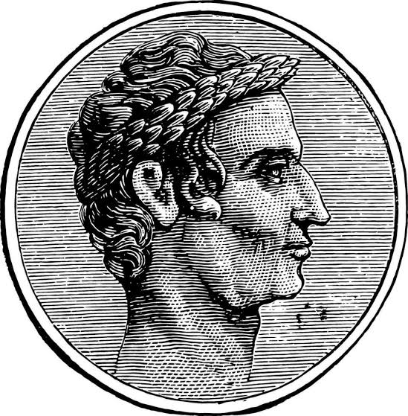
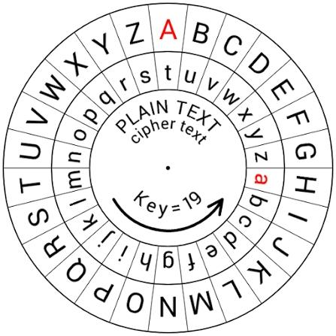
Caesar Cipher – Theory
Developed by Julius Caesar for secret messagesEach letter shifted by a fixed numberExample: Shift=3 → HELLO→KHOOR

Slide 7
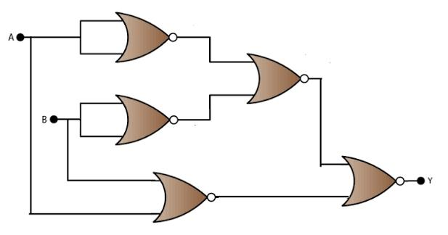
XOR Cipher – Theory
Uses XOR logical operationWorks on binary level comparing text and key bitsSame bits=0, different bits=1Simple, fast, reversible

Slide 8
AES – Advanced Encryption Standard
Modern symmetric encryption algorithmSame key for encryption & decryptionSupports 128, 192, 256-bit keysUsed by banks & governments

Slide 9
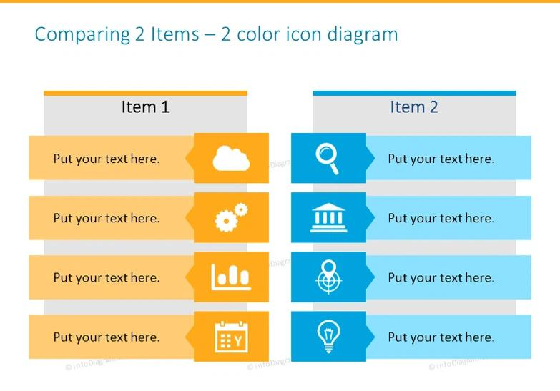
Comparison
Caesar – Fixed shift, WeakXOR – Simple key, MediumAES – Complex key, Very strong

Slide 10

Conclusion
Encryption protects informationCaesar Cipher – SimpleXOR Cipher – LogicalAES – Strong and practicalEncryption = Safety + Privacy + Trust

Slide 11


